Slide 1

Prediction Challenge #1
Vraj Desai

Slide 2
Predictions
Intuition
Score of exams matter considerably more than participation
Asking questions and leaving early are harder parts of the grader to assume
No patterns were found to show students that left early or never did achieved a certain set of scores
Scores >80 led to A’s even with 0 participation
Thus, participation isn’t as a big deal as it seems

Slide 3
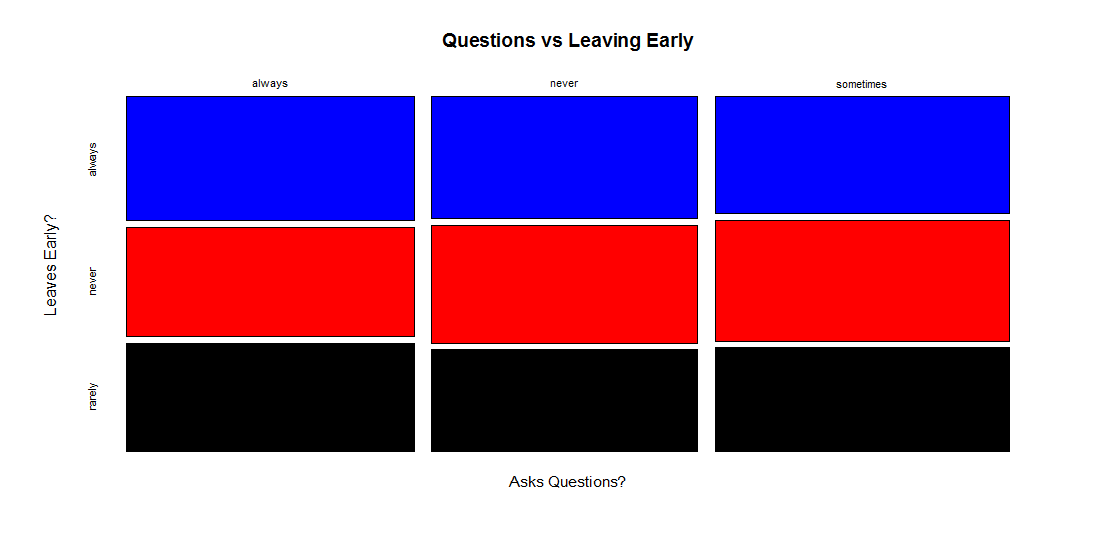
No major correlation b/t leaving and questions

Slide 4
Findings
Grade mainly involves a combination of Scores and Participation
Discovered that Scores are heavily weighted in comparison to Participation
Trial & Error on R Studio
Used the training file and tried out various constant ratios for each grade level
Came up with function of Grade = (Score * .8) + (Participation * .2)
Lowest error I could find of .189
Every grade level has a different cutoff
Since this is a tougher classes, there will be a curve at the end so it is not the common 90 is an A

Slide 5
Conclusion
Tried plotting different variables of the grade…found no link
Used intuition to realize that number values will affect Grade the most
Even though question and going to class are important, there was no significant correlation of the two that affected a grade in 1 direction
In all, grades will be a function of both scores on exams and participation
Scores will be more heavily emphasized as some students will not choose to participation if they already know the material
Obviously, participation helps….but not to a great extent

